Slide 1
Yonnondio
A song, a poem of itself – the word itself a dirge,
Amid the wilds, the rocks, the storm and wintry night,
To me such misty, strange tableaux the syllables calling up;
Yonnondio – I see, far in the west or north, a limitless ravine, with plains and mountains dark,
I see swarms of stalwart chieftains, medicine-men, and warriors,
As flitting by like clouds of ghosts, they pass and are gone in the twilight,
(Race of the woods, the landscapes free, and the falls!
No picture, poem, statement, passing them to the future:)
Yonnondio! Yonnondio! – unlimn’d they disappear;
To-day gives place, and fades – the cities, farms, factories, fade;
A muffled sonorous sound, a wailing word is borne through the air for a moment,
Then blank and gone and still, and utterly lost.

Slide 2
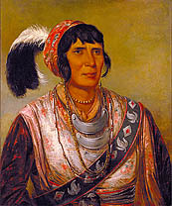
Yonnondio (The sense of the word is lament for the aborigines. It is an Iroquois term.)
Osceola by George Catlin 1838

Slide 3
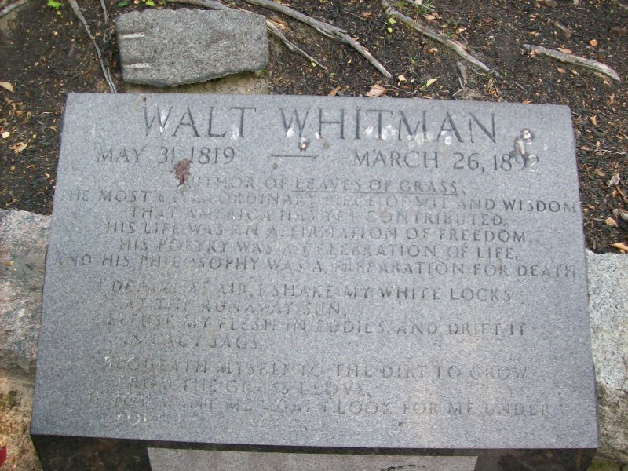
A song, a poem of itself – the word itself a dirge,

Slide 4
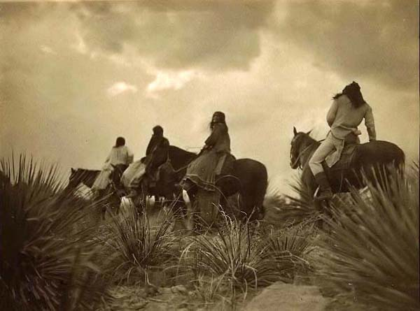
Amid the wilds, the rocks, the storm and wintry night,

Slide 5
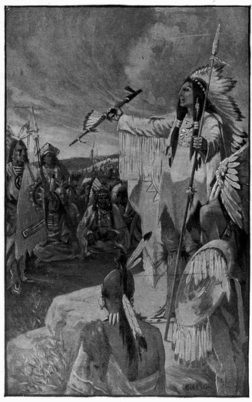
To me such misty, strange tableaux the syllables calling up;

Slide 6
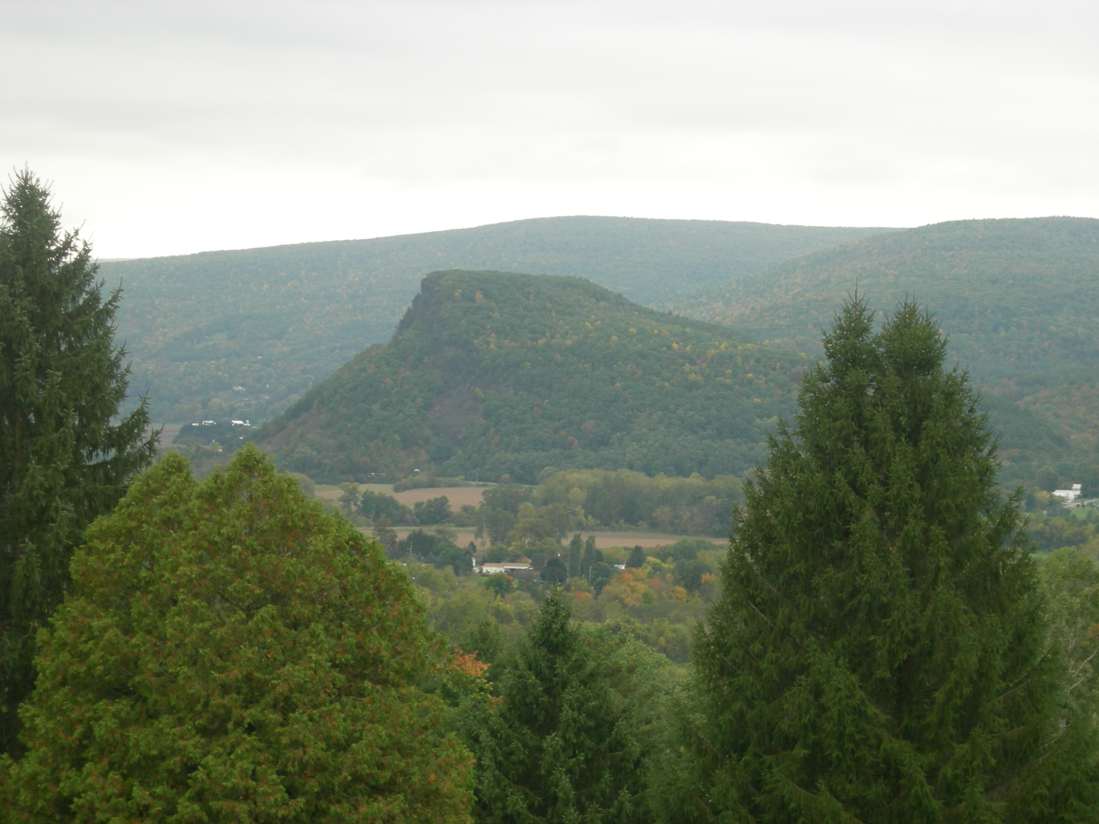
Yonnondio – I see, far in the west or north, a limitless ravine, with plains and mountains dark,
To me such misty, strange tableaux the syllables calling up;
Yonnondio – I see, far in the west or north, a limitless ravine, with plains and mountains dark,

Slide 7
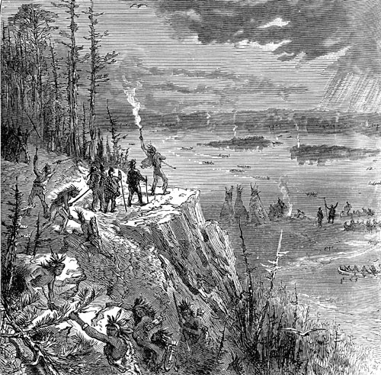
I see swarms of stalwart chieftains, medicine-men, and warriors,

Slide 8
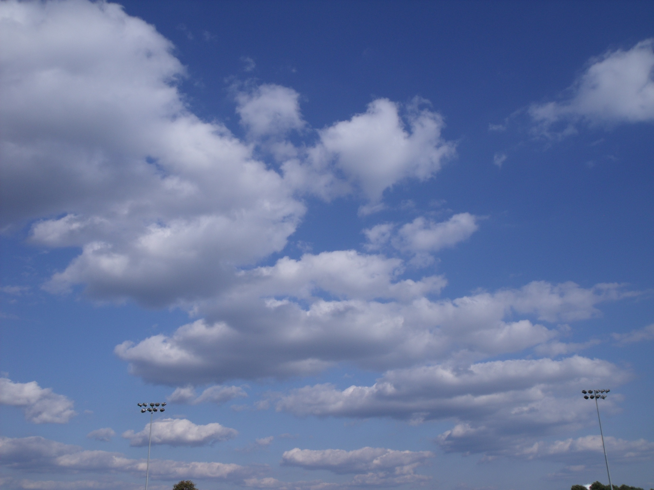
10/5/09 4:04 pm
As flitting by like clouds of ghosts,

Slide 9
They pass and are gone in the twilight,
10/5/09 4:10 pm

Slide 10
(Race of the woods, the landscapes, free, and the falls!
10/5/09 4:15 pm

Slide 11
No picture, poem, statement, passing them to the future:)
10/5/09 4:21 pm

Slide 12
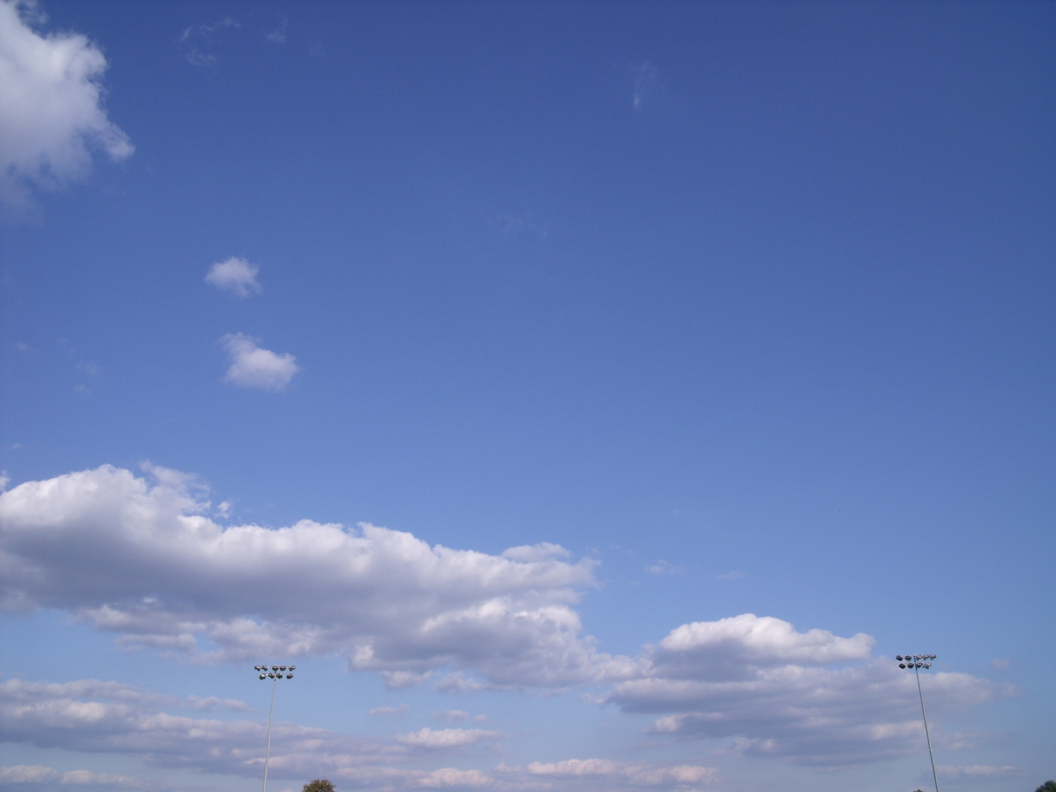
Yonnondio! Yonnondio! – unlimn’d
they disappear;
10/5/09 4:27 pm

Slide 13
To-day gives place, and fades -
10/5/09 4:33 pm

Slide 14
The cities, farms, factories fade;
10/5/09 4:40 pm

Slide 15
A muffled sonorous sound,
10/5/09 4:48 pm

Slide 16
a wailing word is borne through the air for a moment,
10/5/09 4:55 pm

Slide 17
Then blank and gone
10/5/09 4:59 pm

Slide 18
and still,
10/5/09 5:05 pm

Slide 19
and utterly lost.
10/5/09 5:11 pm

